Slide 1
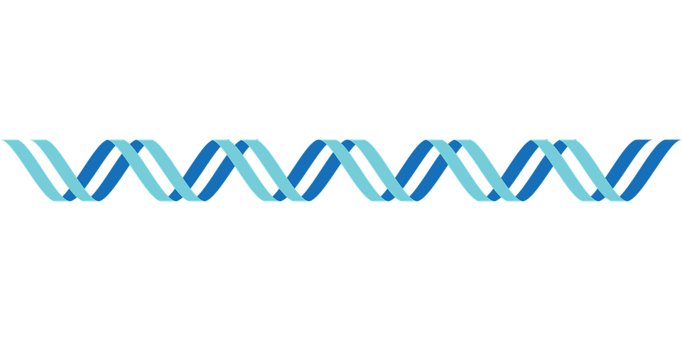
DNA Punch cards
By: Shanav Nath & Trevor Sloan

Slide 2
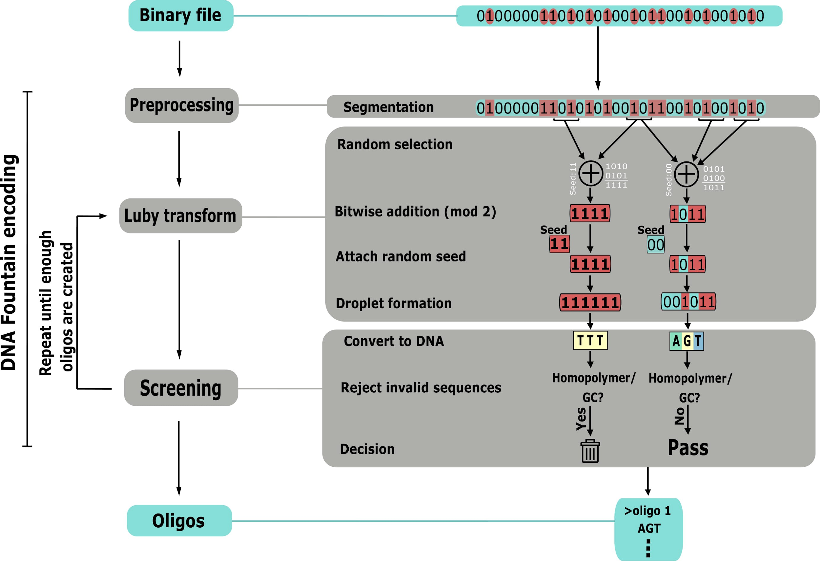
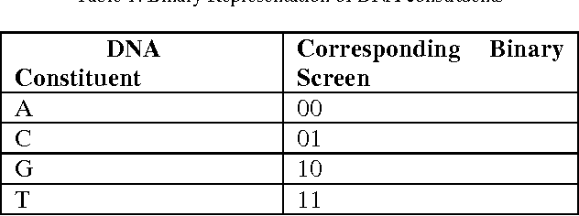
Prior Methods
DNA-based storage systems currently all store data in synthetic DNA oligos
Requires synthesizing strands with precise orderings of nucleotides
DNA Fountain

Slide 3
Writing

Slide 4
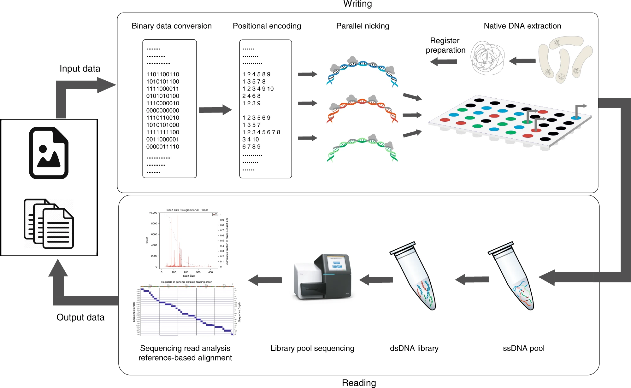
Reading
DNA first converted to single strands using high temperatures at the nicks
The pieces are then converted to dsDNA to be sequenced
Error-free as reads can always be aligned with the reference

Slide 5
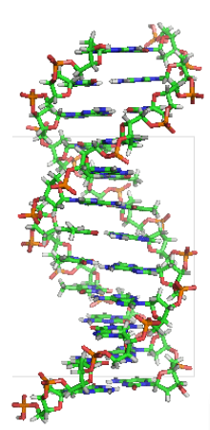
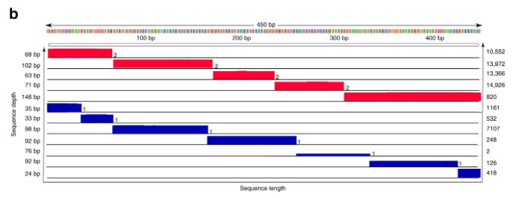
Data Compression

Slide 6
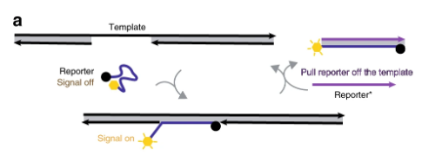
Random Access

Slide 7
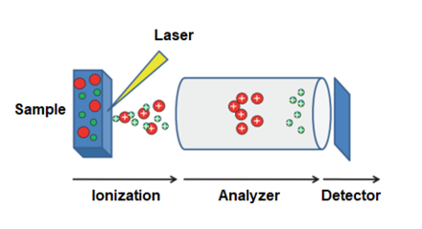
Future Developments
MALDI Plates
Microfluidic Devices
Use with synthetic DNA

